Slide 1
Washington State Assessments, 2011
Have we moved the needle?

Slide 2
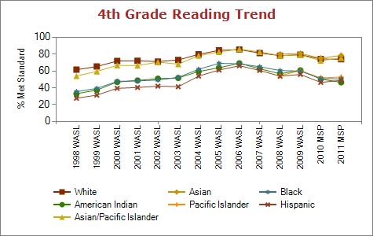

Slide 3
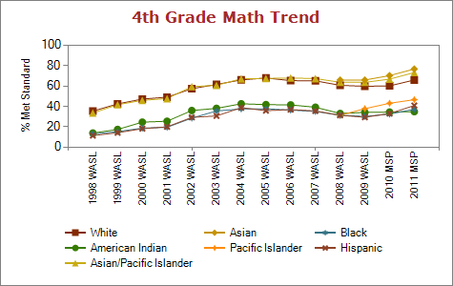

Slide 4
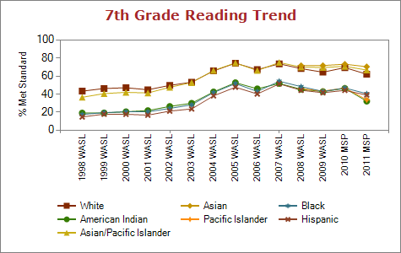

Slide 5
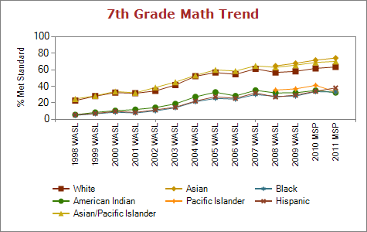

Slide 6
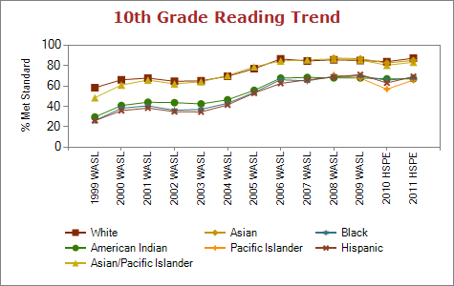

Slide 7
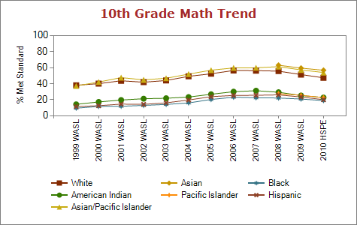

Slide 8
Percent of Black Students Meeting Standard in Reading by ELL Status (2011)

Slide 9
Percent of Black Students Meeting Standard in Math by ELL Status (2011)
* 10th Grade is End of Course Year 1

Slide 10
Percent of Hispanic Students Meeting Standard in Reading by ELL Status (2011)

Slide 11
Percent of Hispanic Students Meeting Standard in Math by ELL Status (2011)
* 10th Grade is End of Course Year 1

